Slide 1
Computer Memory Unit
Lecture 3

Slide 2

Memory
Computer memory is the storage space in the computer, where data is to be processed and instructions required for processing are stored. It is used to store data and instructions. The memory is divided into large number of small parts called cells. Each location or cell has a unique address. For example, if the computer has 64k words, then this memory unit has 64 * 1024 = 65536 memory locations. The address of these locations varies from 0 to 65535.

Slide 3
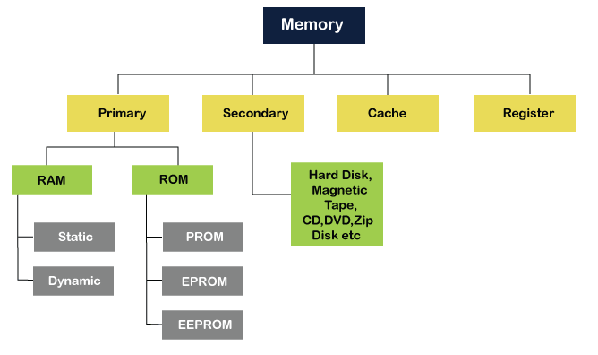
Classification

Slide 4
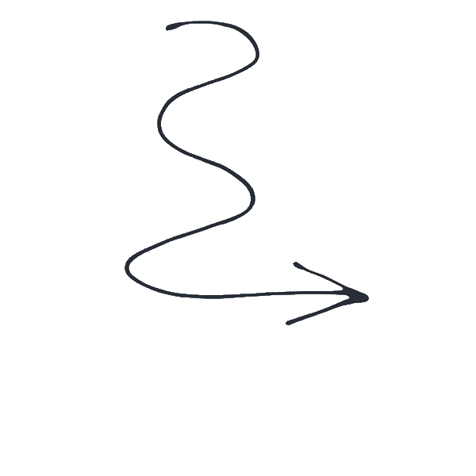
Home Task
Find out the differences between primary memory and secondary memory

Slide 5
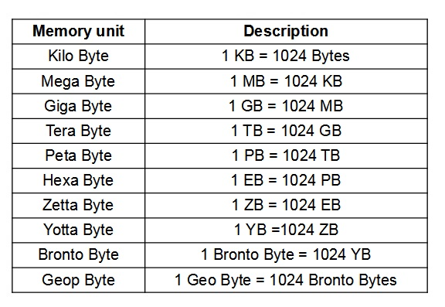
Measuring Memory
The primary or internal storage unit is made up of several small storage locations called cells. Each of these cells can store a fixed number of bits called word length. Each cell has a unique number assigned to it called the address of the cell and it is used to identify the cells.
You know that data in computer is stored in the form of 0s and 1s. Each of these digits is known as a bit. A collection of 8 bits constitutes a byte. Each cell of memory contains one character or 1 byte of data. So the capacity is defined in terms of bytes or words. However higher units of memory are Kilobytes, Megabytes, Gigabytes etc. 1 Kilobyte is equal to 1024 bytes. Thus 64 Kilobyte (KB) memory is capable of storing 64 × 1024 = 32,768 bytes.

Slide 6
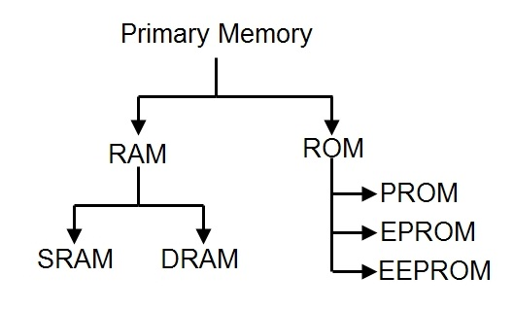
Primary Memory
Primary memory is the memory that is accessed by the processor directly. It is also known as main memory or internal memory. It helps in executing applications that are temporarily stored in a specific memory location. Primary memory is of two types – RAM and ROM.

Slide 7
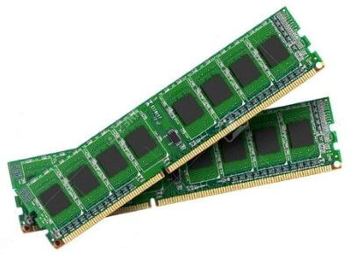
Random Access Memory (RAM)
Random Access Memory (RAM) is the type of memory in which it is possible to randomly select and use any location of the memory directly to store and retrieve data. It is also called as read/write memory. Since it is volatile, the data from RAM is lost as soon as the power to the computer is switched off.

Slide 8
Random Access Memory (RAM)
Static RAM
SRAM is faster compared to DRAM.
It does not have a refreshing unit.
These are expensive.
In this bit are stored in voltage form.
SRAM has higher data transfer rate
SRAM is used in high performance applications
Dynamic RAM
DRAM provides slow access speeds.
It has a refreshing unit.
These are cheaper.
In this bit is stored in the form of electric energy.
DRAM has lower data transfer rate
DRAM is used in general purpose applications

Slide 9
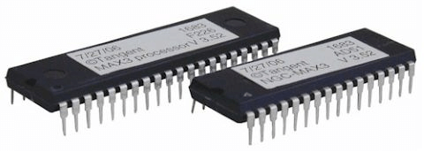
Read Only Memory (ROM)
This is another type of primary memory from which data can only be read. We cannot write or modify data once written on to the ROM. Also this type of primary memory is not volatile. The storage of program and data in the ROM is permanent. The ROM stores some standard processing programs supplied by the manufacturers to operate our computer. The Basic Input Output System (BIOS) is stored in the ROM. It examines and initializes the start up process of the computer and also checks various peripheral devices attached to the PC when the computer is turned ON.

Slide 10
Read Only Memory (ROM)
Programmable Read Only Memory (PROM):
it is not possible to modify or erase programs stored in ROM, but it is possible for you to store your program in PROM chip. Once the programs are written it cannot be changed. Also the program is not lost even if power is switched off.
Erasable Programmable Read Only Memory (EPROM) :
This type of ROM overcomes the problem of PROM and ROM. EPROM chip can be programmed time and again by erasing the information stored earlier in it. Information stored in EPROM can be erased by exposing it to ultraviolet light. This memory can be reprogrammed using a special programming facility.
Electrically Erasable Programmable Read Only Memory(EEPROM):
The only difference is that unlike EPROM, electrical signals are used to erase the contents of EEPROM. Also, this type of ROM need not be completely erased. Partial modification of ROM is possible.

Slide 11
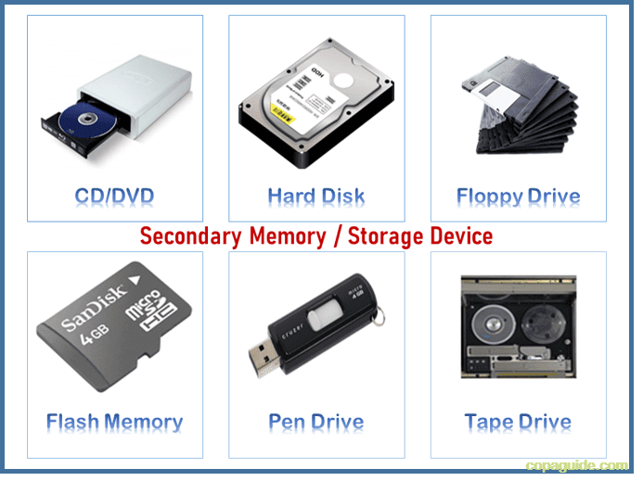
Secondary Memory
This type of memory is also known as external memory or non-volatile. It is slower than the main memory. These are used for storing data/information permanently. CPU directly does not access these memories, instead they are accessed via input-output routines. The contents of secondary memories are first transferred to the main memory, and then the CPU can access it. For example, disk, CD-ROM, DVD, etc.
Find out more info about Magnetic Tape, Magnetic Disk, Floopy Disk, HDD.

Slide 12
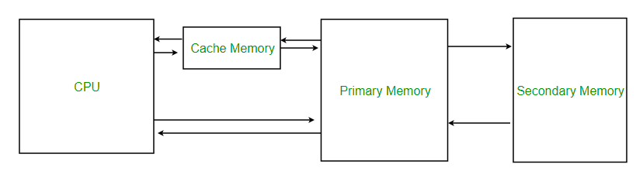
Cache Memory
To increase the performance of CPU, a small memory chip is attached between CPU and main memory whose access time is very close to the processing speed of CPU. This memory is called as Cache memory. It is used to store programs or data currently being executed or data that is being frequently used by the CPU. Fast access of these data and instructions increases the overall execution speed of the software. It is very expensive memory and so has to be used in a limited amount. Cache memory is also known as CPU memory. It is either integrated directly with the CPU chip or is placed separately on the motherboard. As the microprocessor processes data, it first looks in the cache memory. If the required data or instructions are found there, it does not have to spend more time in reading data from other storage devices that have slower access time. Hence the processing speed increases.

Slide 13
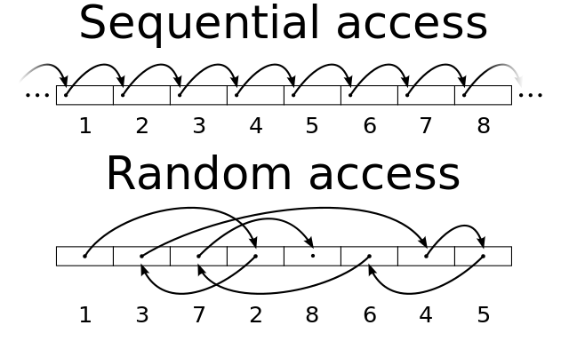
MEMORY ACCESSING MODES
Direct Access or Random Access:
It is the type of accessing mode in which the value to be stored in a particular memory location is obtained directly. Since the data can be accessed in any order that is why this type of memory access is also known as random access of memory. This type of memory access is generally fast and more flexible. The type to be stored in memory is obtained directly by retrieving it from another memory location. This type of memory access is based on the principle that any piece of data can be returned in a constant time, regardless of its physical location and previous access. The web uses direct memory access mode.

Slide 14
MEMORY ACCESSING MODES
Sequential Access memory:
It is the type of memory in which the stored data is read in sequence. That means if you want to display the fourth record, the reading will start from the first record and then move to second, third and then fourth record. This type of memory access can be time consuming and hence slow, especially when the data to be read is towards the end. Sequential access devices are generally a form of magnetic storage. Hard disks, CD-ROMs and magnetic tapes use sequential access of memory.

Slide 15
That’s all for today….see you in next class!!

